Slide 1

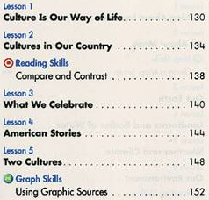
Table of Contents
A table of contents gives the heading and beginning page number of each section in a book.

Slide 2
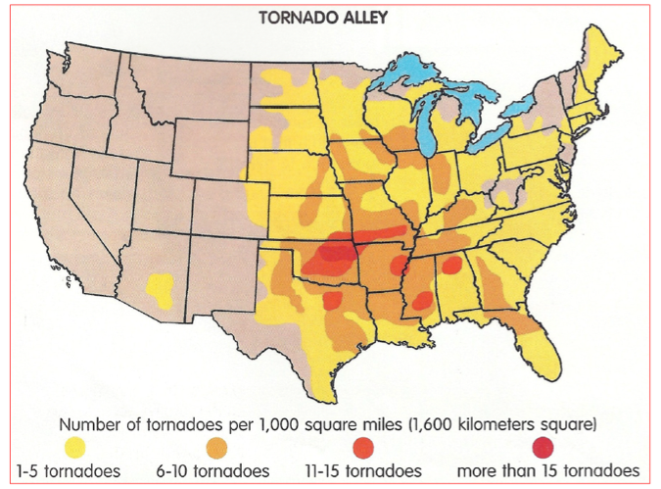
maps
A map is a picture that shows the location of things or places.

Slide 3
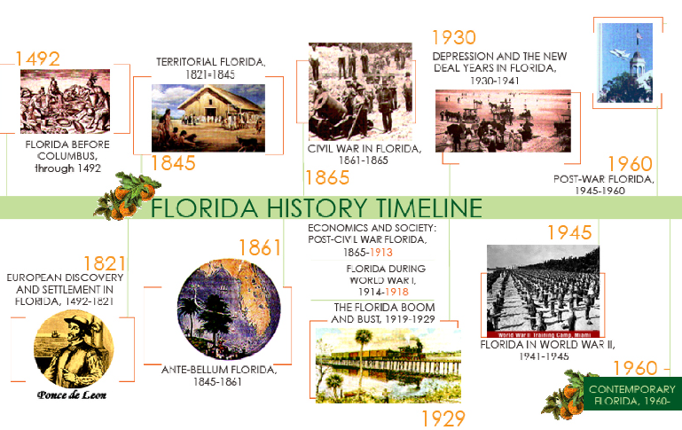
Time lines
A timeline is a chart that helps a reader see important events in chronological order.

Slide 4

Captions
A caption is the words next to or underneath a picture that explain what it is or is about.

Slide 5

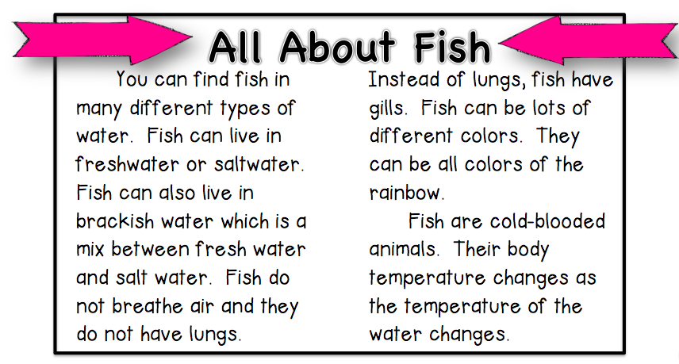
headings
A heading tells the reader what the section is about.

Slide 6
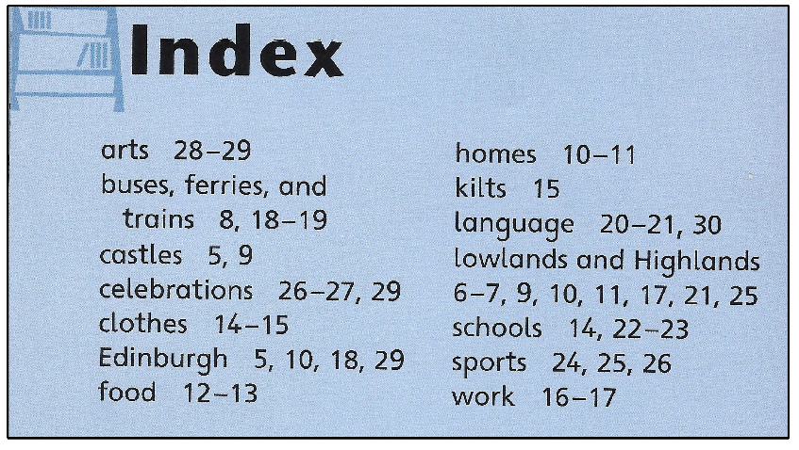
index
An alphabetical list of important subjects in the text that is located in the back of a book.

Slide 7
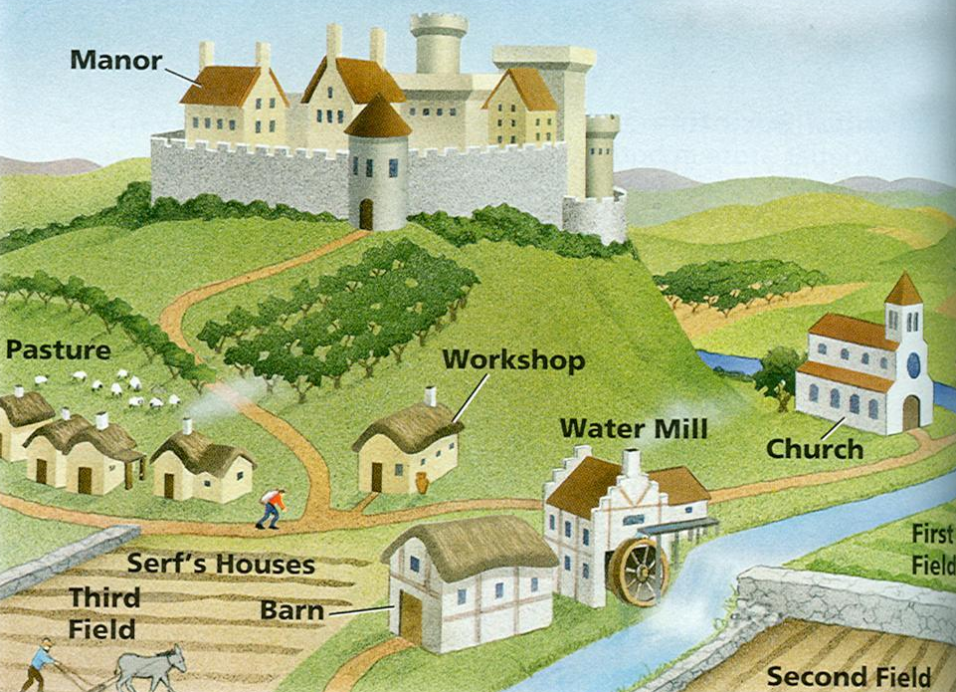
diagrams
A diagram is a drawing that shows the parts of something.

Slide 8
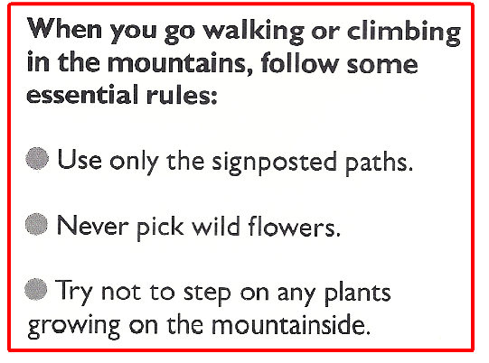
bullets
Bullets organize information in a list.

Slide 9

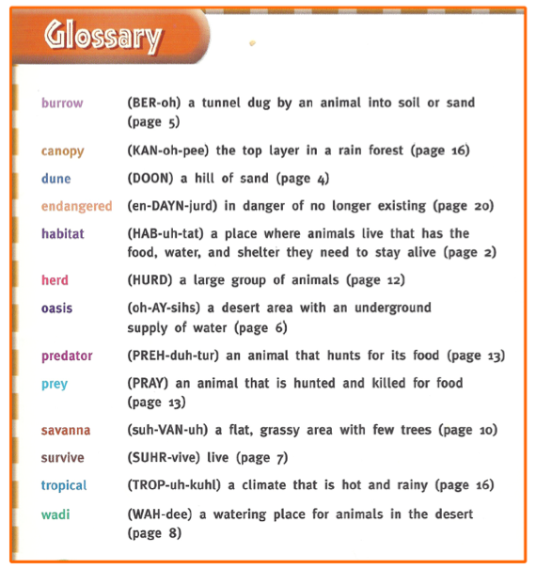
glossary
A glossary alphabetically lists new or important words and shows or tells what they mean.

Slide 10
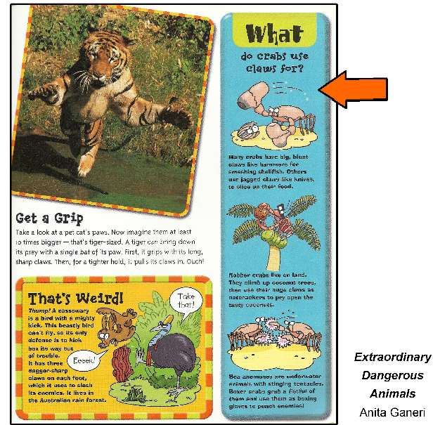
Insets & sidebars
An inset or sidebar gives additional information related to a topic or picture.

Slide 11
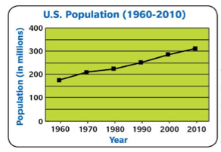
Charts & graphs
A graph shows information in a visual way so that it is more easily understood by readers.

Slide 12
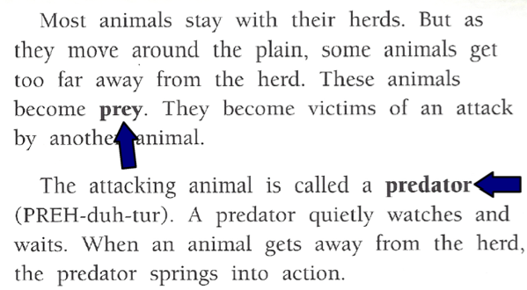
Types of print
Colored, bolded, italicized, or highlighted words identify new or important words and concepts.

